Slide 1
Data Analytics Career Opportunities
Where your data analytics career begins

Slide 2
Table of contents
01
02
Project Overview
The purpose of this project is to educate and inform students of their career options after completion of this program.
What We Will Discuss
An overview of our experiences and challenges during this project.
Statewide salary information
Helpful links

Slide 3
About me
Mercury is the closest planet to the Sun and the smallest one in the Solar System—it’s only a bit larger than the Moon. The planet’s name has nothing to do with the liquid metal, since Mercury was named after the Roman messenger god
WHAT IS OUR “ABOUT ME”?

Slide 4
Annual Income
01
03
02
04
Median
Entry-Level
$$$$
$$$$
Minimum
$$$$
$$$$
Maximum

Slide 5
Job position 1
Company name here
20XX -20XX
You can describe the topic of the section here
List your responsibilities for this job
Adapt this to your needs
Try to keep it short
Go straight to the point
Don’t omit important information

Slide 6
Education
01
02
03
20XX - 20XX
Mercury is the closest planet to the Sun
20XX - 20XX
Pluto is now considered a dwarf planet
20XX - 20XX
Venus is the second planet from the Sun

Slide 7
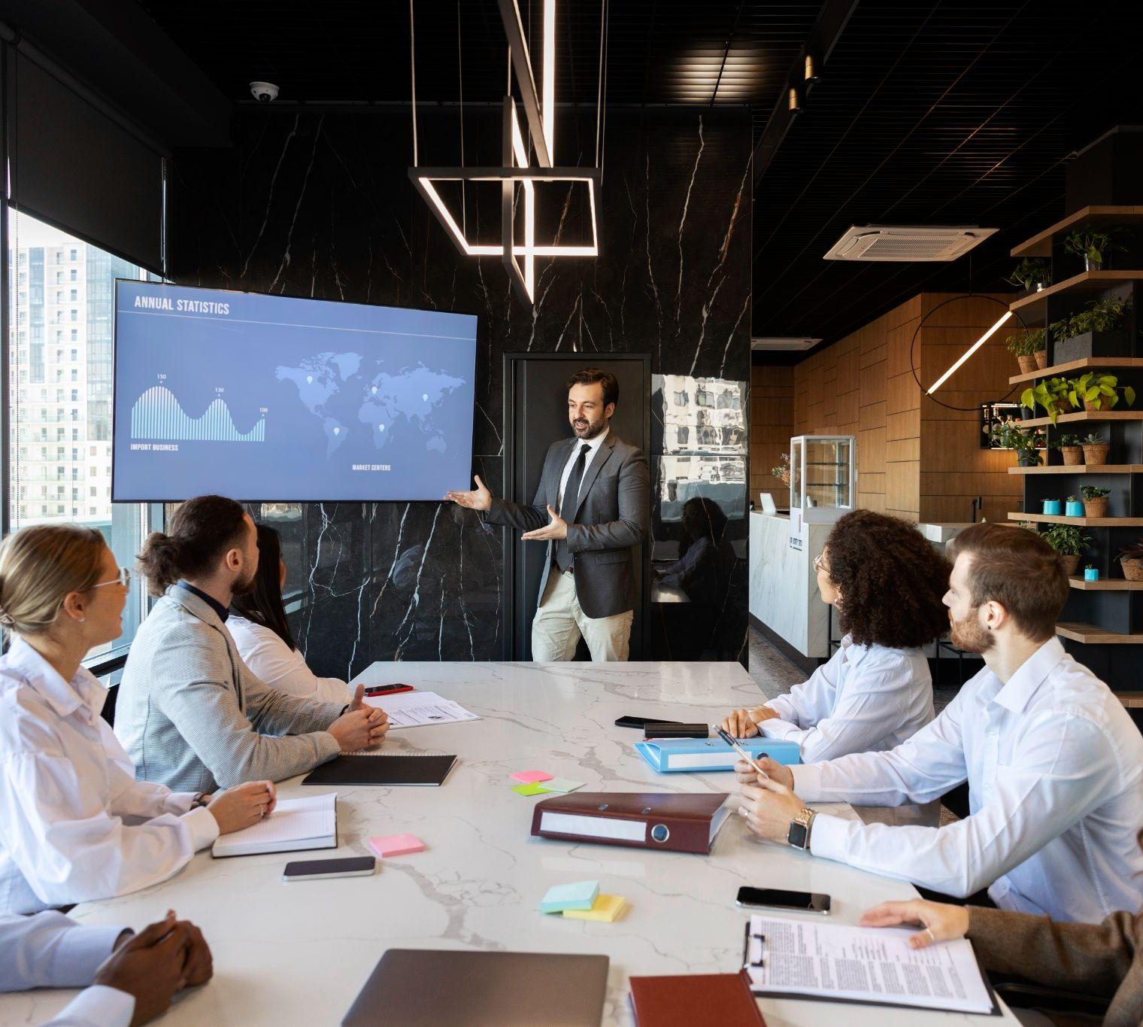
A picture always reinforces
the concept
Images reveal large amounts of data, so remember: use an image instead of a long text. Your audience will appreciate it

Slide 8
Institution 1
Institution name here
20XX-20XX
Principal subjects:
Occupational skills:
List the subjects here
Sort them by relevance
Adapt this to your needs
Try to keep it short
Go straight to the point
List the subjects here
Sort them by relevance
Adapt this to your needs
Try to keep it short
Go straight to the point

Slide 9
Possible Career Fields
Data Analytics
Full-Stack Delevoper
JavaScript Deveopler
SQL Administrator

Slide 10
Computer skills
Office
Web browser
Typing
Venus has extremely high temperatures
Saturn is not the only planet with rings
Despite being red, Mars is very cold

Slide 11
—Someone Famous
“This is a quote, words full of wisdom that someone important said and can make the reader get inspired.”

Slide 12

A picture is worth a thousand words

Slide 13
Achievement
Do you know what helps you make your point crystal clear? Lists like this one:
They’re simple
You can organize your ideas clearly
You’ll never forget to buy milk!
And the most important thing: the audience won’t miss the point of your presentation

Slide 14
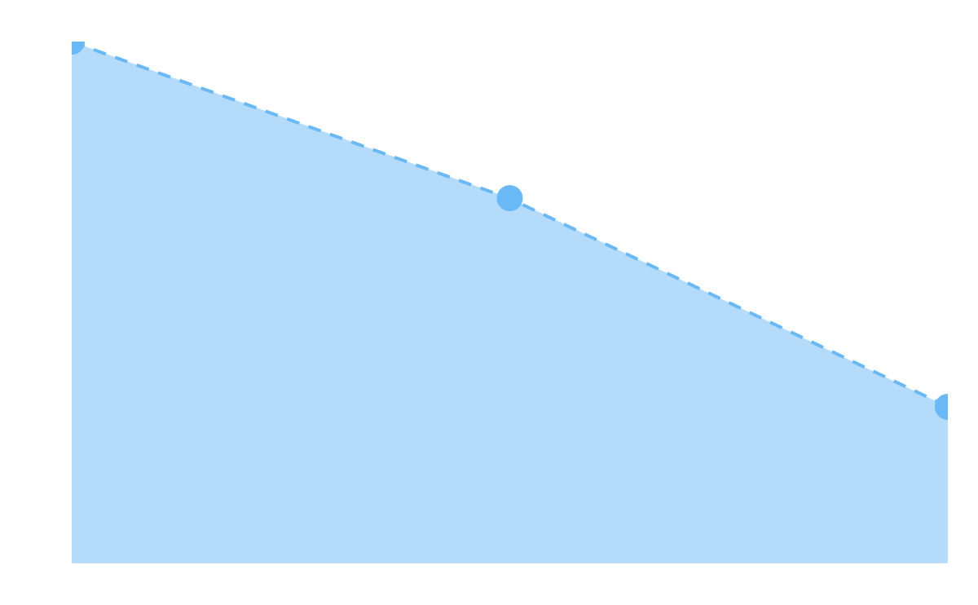
Communication skills
English
100%
Mercury is the closest planet to the Sun
French
70%
Venus is the second planet from the Sun
Italian
30%
Despite being red, Mars is very cold
Follow the link in the graph to modify its data and then paste the new one here. For more info, click here

Slide 15
Volunteer work
Thailand
Neptune is the fourth-largest planet in the Solar System
EE.UU.
Saturn is the second-largest planet in the Solar System

Slide 16
Volunteer work
Date | Company | Description
2017 | Venus | Description 1
2019 | Mars | Description 2
2021 | Mercury | Description 3

Slide 17
Technical knowledge
90%
75%
50%
Python
Java
Tableau
Mercury is the closest planet to the Sun and the smallest one in the Solar System
Venus has a beautiful name and is the second planet from the Sun
Despite being red, Mars is actually a cold place. It’s full of iron oxide dust

Slide 18
Some key problem-solving skills
Analysis
Research
Creativity
Venus is the second planet from the Sun
Mars is actually a very cold place
Saturn is not the only planet with rings
Team building
Decision making
Active listening
Jupiter is the biggest planet of them all
Neptune is far away from Earth
Earth is the planet where we all live

Slide 19
Analytical skills
Competitive analysis
Saturn is not the only planet with rings
Market analysis
Neptune is far away from Earth
Performance analysis
Earth is the planet where we all live

Slide 20
Hobbies
Photography
Travel
Read
Mars is actually a very cold place
Earth is the planet where we all live
Neptune is far away from Earth

Slide 21

Computer Mockup
You can replace the image on the screen with your own work. Just right-click on it and select “Replace image”

Slide 22
Thanks
DO YOU HAVE ANY QUESTIONS?
youremail@freepik.com
+34 654 321 432
yourwebsite.com
Please keep this slide for attribution

Slide 23
Resources
Vectors:
Wavy abstract background
Abstract paper background
Photos:
Rpa concept with blurry hand touching screen
People taking part of business event
Icon Pack:
Startups | Lineal

Slide 24

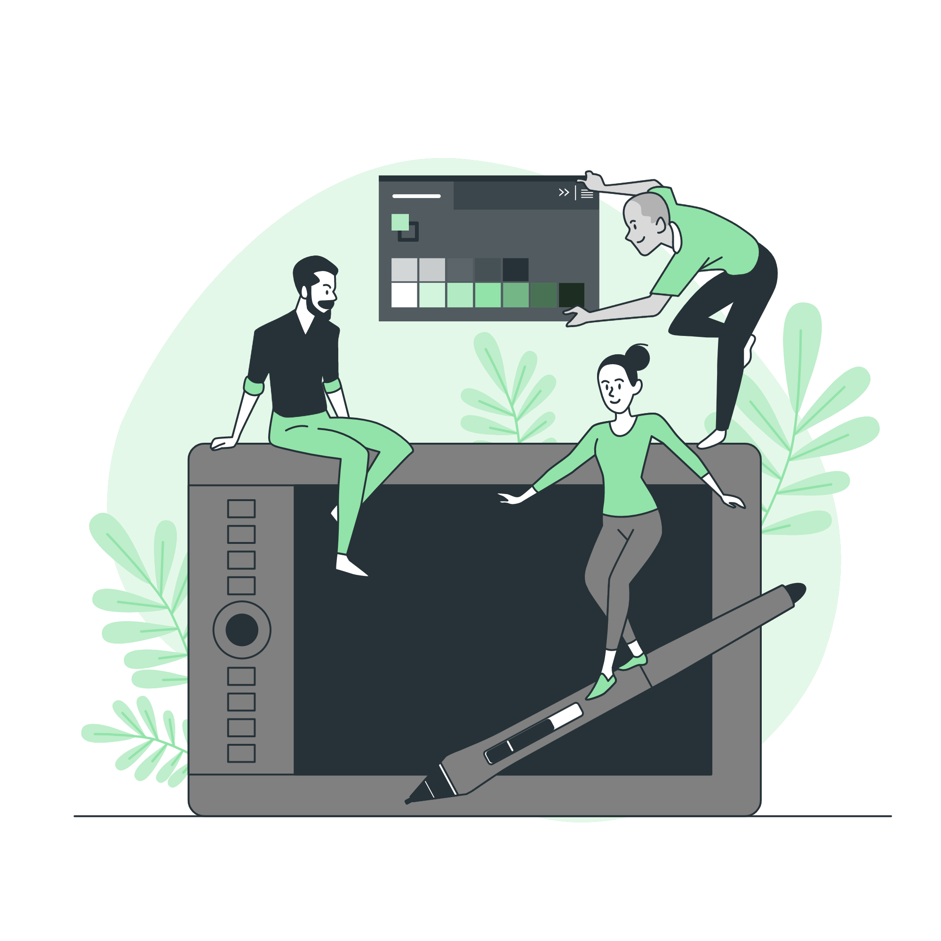



Project Contributors
Create your Story with our illustrated concepts. Choose the style you like the most, edit its colors, pick the background and layers you want to show and bring them to life with the animator panel! It will boost your presentation. Check out how it works.
Pana
Amico
Bro
Rafiki
Cuate

Slide 27
...and our sets of editable icons
You can resize these icons without losing quality.
You can change the stroke and fill color; just select the icon and click on the paint bucket/pen.
In Google Slides, you can also use Flaticon’s extension, allowing you to customize and add even more icons.

Slide 28
Educational Icons
Medical Icons

Slide 29
Business Icons
Teamwork Icons

